Slide 1
DATE
Chelsea Rendell
Insert some kind of cool picture here

Slide 2
TABLE OF CONTENTS
TABLE OF CONTENTS
WHERE
1
2
3
4
Personal
Community
Global
Aspirational

Slide 3
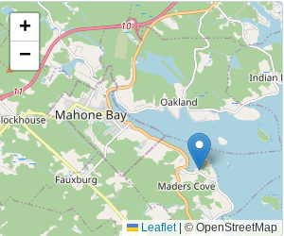
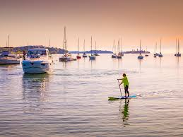
The Personal Place
Cit 9 WHERE
MAP SCREENSHOT (from Bing Maps) | I chose Maders cove located in Mahone bay .My cottage is located in Maders cove and I have been going there every summer for 14 years. I like going there because I love swimming in the ocean, going tubing and wakeboarding. There is lots of islands we go to and spend the day there. In conclusion Maders Cove is my favorite place to go to in the summer. | IMAGE
Notes:
The Personal Place
Reflection: Write a paragraph about a personal place that holds significance for you.
Guiding Questions:: In a second section, describe how your personal perspective shapes the way you see and feel about this place. What stories or memories are tied to this specific location?

Slide 4
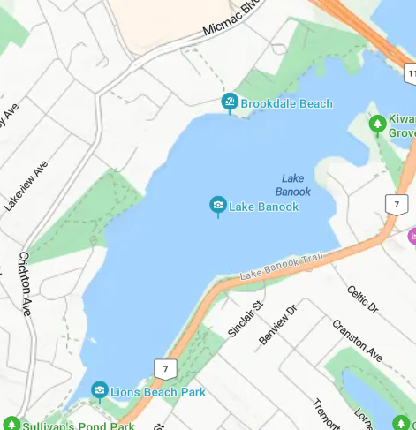

The Community Place
Cit 9 WHERE
MAP SCREENSHOT | For my community place I chose Lake Banook/ Senobe. I chose this because I am here a lot. The connection I have with senobe/ lake Banook is I paddle at senobe. The reason i'm here a lot is because my practices are everyday (winter,fall,spring) for 2 hours and in the summer i'm there all day. In conclusion I chose Lake banook/senobe because its like my second home because i'm there as much or more then my actual house. | IMAGE
Notes:
Reflection: Write about a significant place in our local community. Tell the story of the place! Who owns it? Why do you like it? Describe something that happened there that you remember.

Slide 5
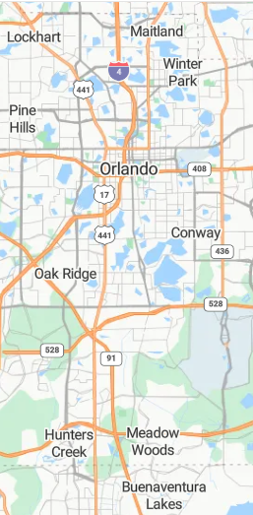
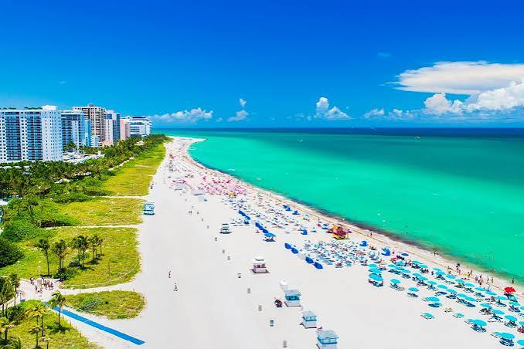
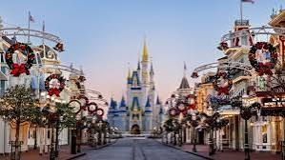
The Global Place
Cit 9 WHERE
MAP SCREENSHOT | I chose orlando florida. The reason I choose florida is because I have been going there every year except we stopped going during covid. I love florida because it has disney and its always warm and great weather and great beaches. My favorite thing about Disney is the Disney water parks like typhoon lagoon. In conclusion Florida is my favorite global place because of the weather, shopping and Disney/Universal. | IMAGE
Notes:
Reflection: Write a story about a place in the world that is part of your family's story.
Guiding Questions: Tell the story of how you and/or your family are connected to this place.
What traditions or values from this place have been passed down to you?
How does this connect to your cultural identity, including things you do and who you are?

Slide 6
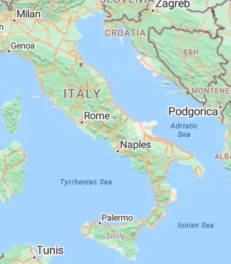
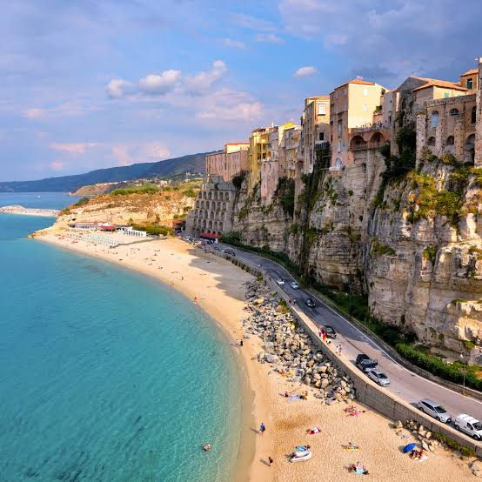
The Aspirational Place
Cit 9 WHERE
MAP SCREENSHOT | A place I want to go is Italy. I want to go to italy because the weather it warm and it seems like a great place to go at least once in your life. I also really like italian food and the water seems amazing there. I also have never been to europe and the people that i know that went there really liked it. In conclusion I really want to go to Italy or somewhere in europe. | IMAGE
Notes:
Reflection: Write a story about a place in the world that is part of your family's story.
Guiding Questions: What draws you to this place? What do you hope to learn or experience there? How does this place fit into your hopes for the future?

Slide 7
The Aspirational Place
Cit 9 WHERE
Soundtrack of your life | Post the youtube link here | What’s the story on the song? Write here!
Notes:
Reflection: Write a story about a place in the world that is part of your family's story.
Guiding Questions: What draws you to this place? What do you hope to learn or experience there? How does this place fit into your hopes for the future?

Slide 8
THANK YOU

